Slide 1
Turkish alphabet
SELMAN TALHA TEZCAN

Slide 2
TURKISH ALPHABET
29 LETTERS
Aa Bb Cc Çç Dd Ee Ff Gg Ğğ Hh Iı İi Jj Kk Ll Mm Nn Oo Öö Pp Rr Ss Şş Tt Uu Üü Vv Yy Zz

Slide 3
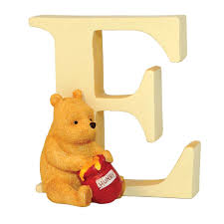
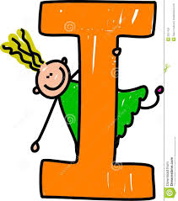
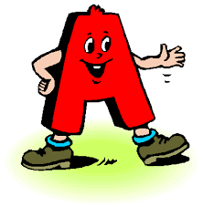

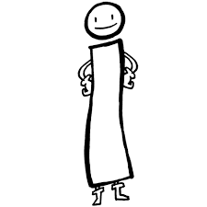
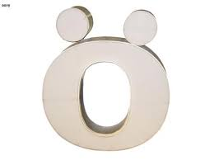


Turkish Alphabet has 8 vowels
1- Aa
2- Ee
3-Iı
4-İi
5-Oo
6-Öö
7-Uu
8-Üü

Slide 4
!!! NOT FOUND IN ENGLISH ALPHABET !!!
Çç Ğğ Iı Öö Şş Üü

Slide 5
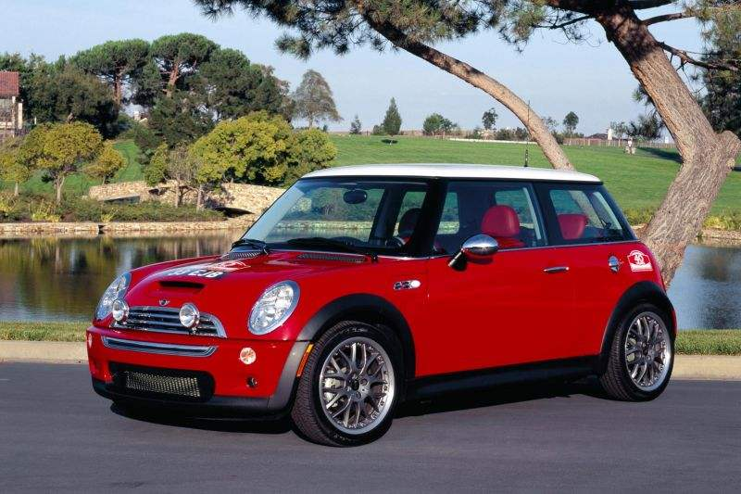
Uppercase letter
A a
Araba
Ar-ra-ba
Lowercase letter
CAR

Slide 6
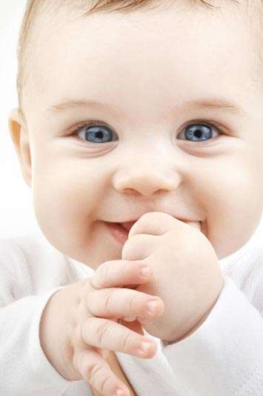
B b
Bebek
Be-bek
BABY

Slide 7
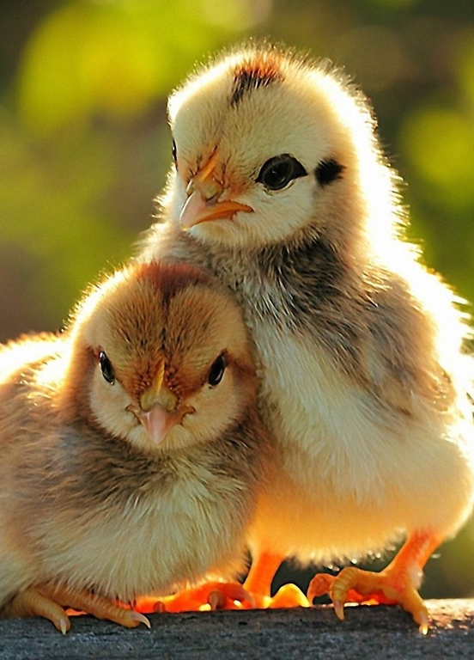
C c
Civciv
Civ-civ
CHICK

Slide 8
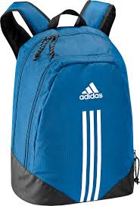
Ç ç
Çanta
Çan-ta
-ch-
chicken
church
BAG

Slide 9
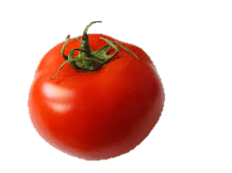
D d
Domates
Do-ma-tes
TOMATO

Slide 10
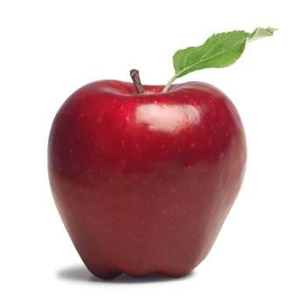
E e
ELMA
EL-MA
APPLE

Slide 11
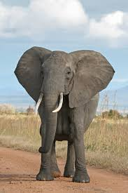
Monosyllabic WORD
F f
Fil
Fil
ELEPHANT

Slide 12
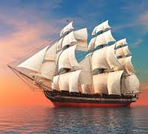
G g
Gemi
Ge-mi
VESSEL

Slide 13
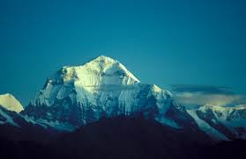
Monosyllabic WORD
Ğ ğ
Dağ
Dağ
MOUNTAIN

Slide 14
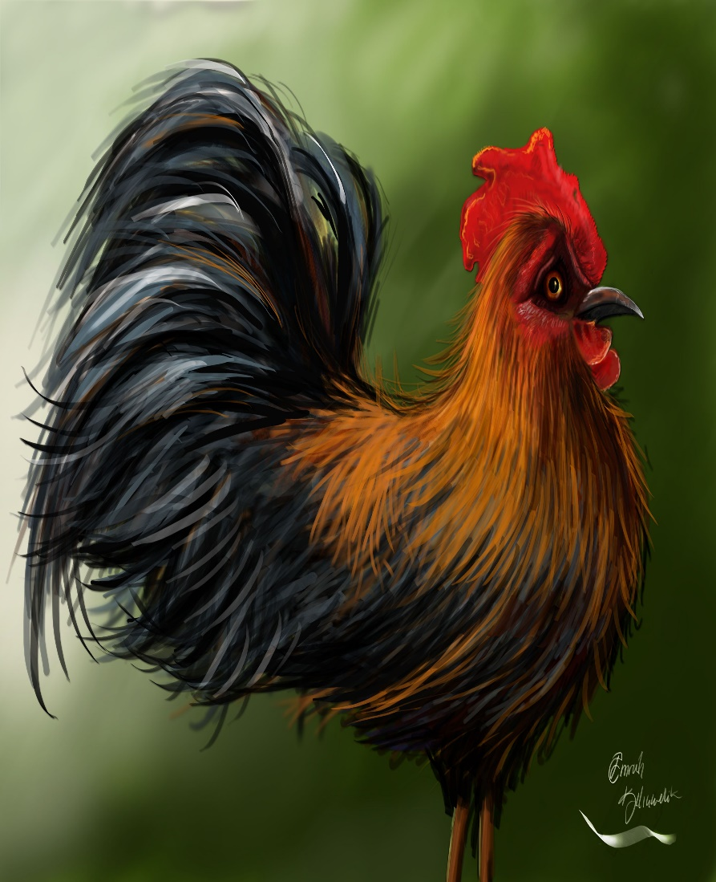
H h
Horoz
Ho-roz
ROOSTER

Slide 15
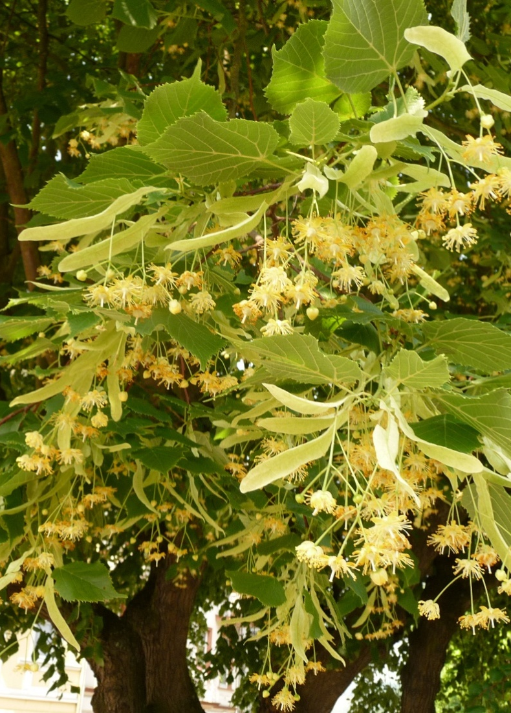
I ı
Ihlamur
Ih-la-mur
LINDEN

Slide 16
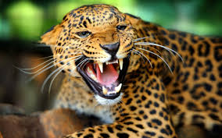
J j
JAGUAR
JA-GU-AR
JAGUAR

Slide 17
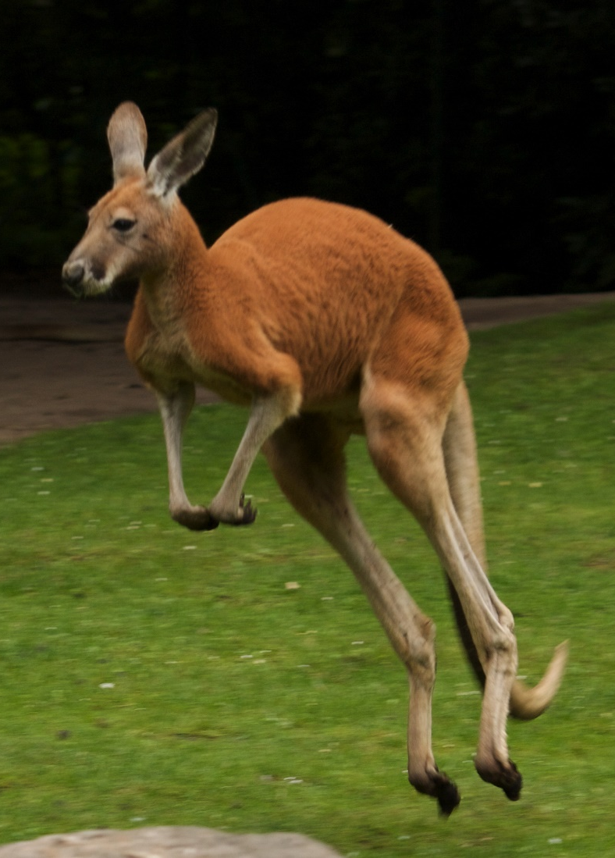
K k
Kanguru
Kan-gu-ru
KANGROO

Slide 18
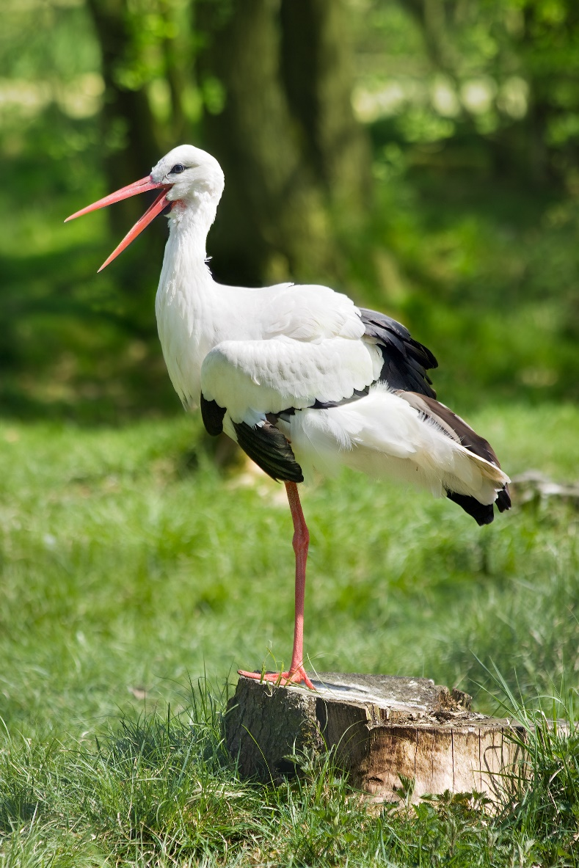
L l
Leylek
Ley-lek
STORK

Slide 19
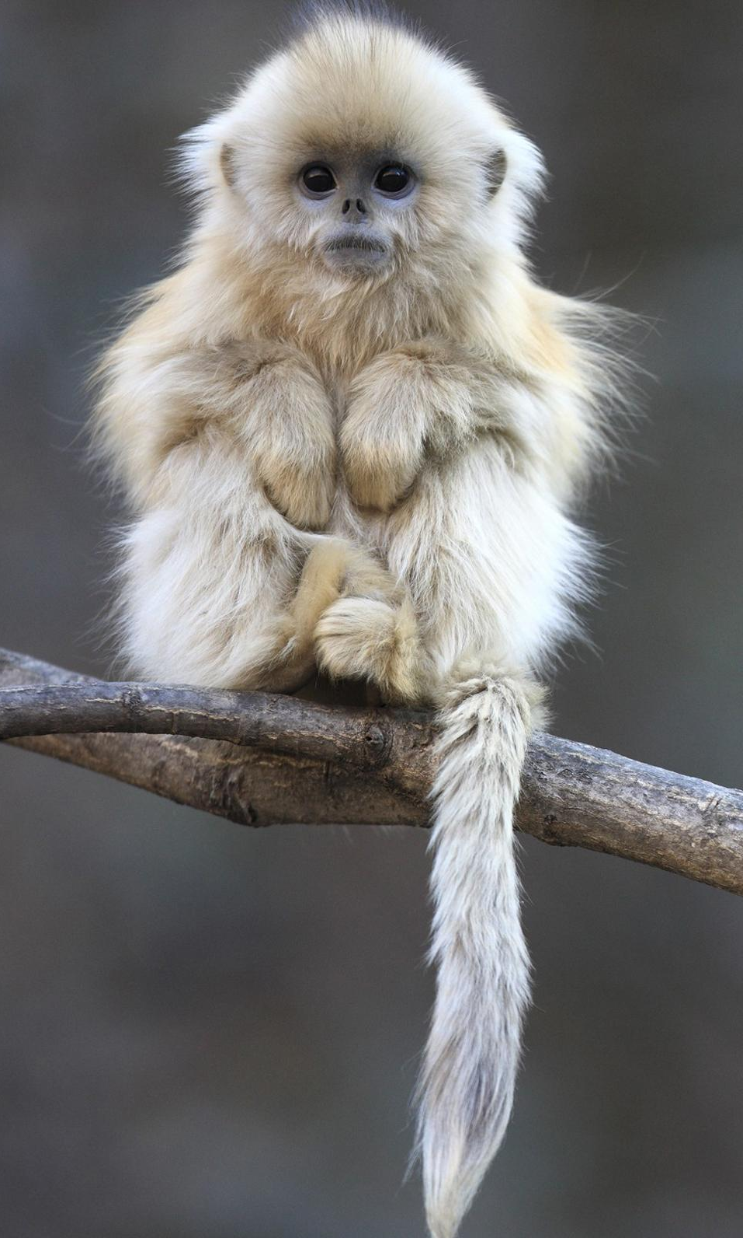
M m
Maymun
May-mun
MONKEY

Slide 20
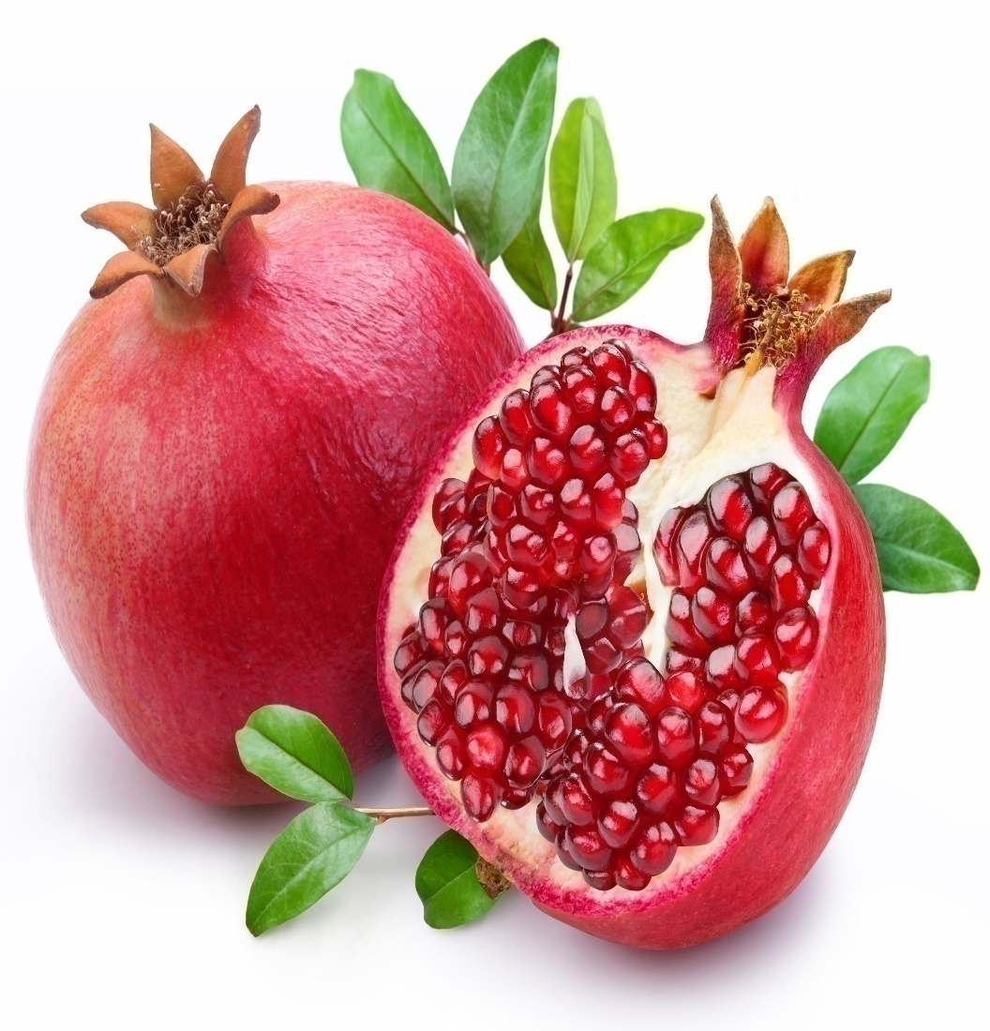
Monosyllabic WORD
N n
Nar
Nar
POMEGRANATE

Slide 21
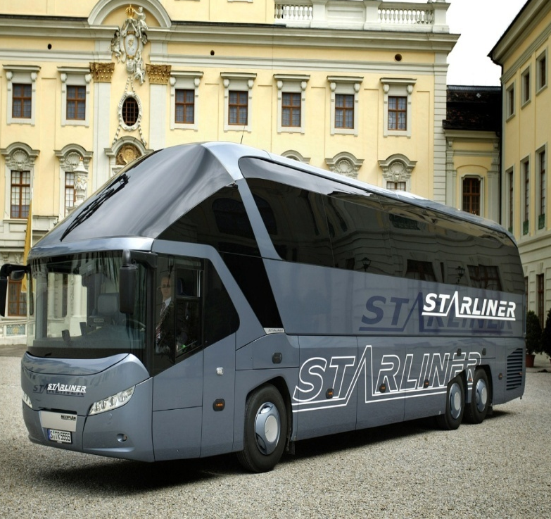
O o
Otobüs
O-to-büs
BUS

Slide 22
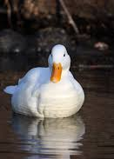
Ö ö
Ördek
Ör-dek
DUCK

Slide 23
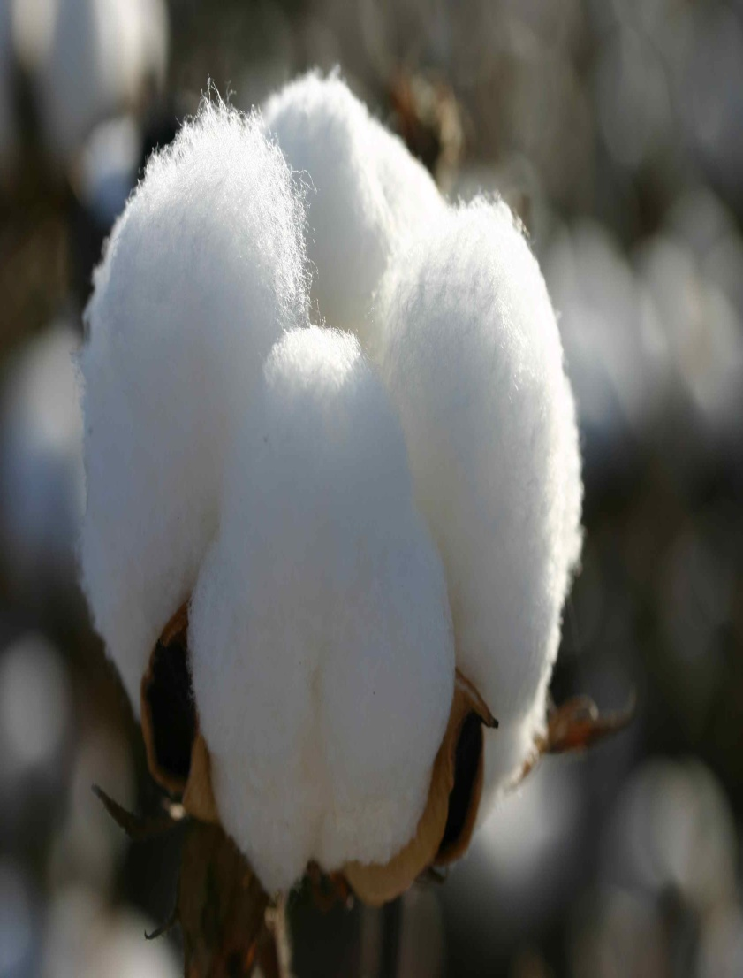
P p
Pamuk
Pa-muk
COTTON

Slide 24
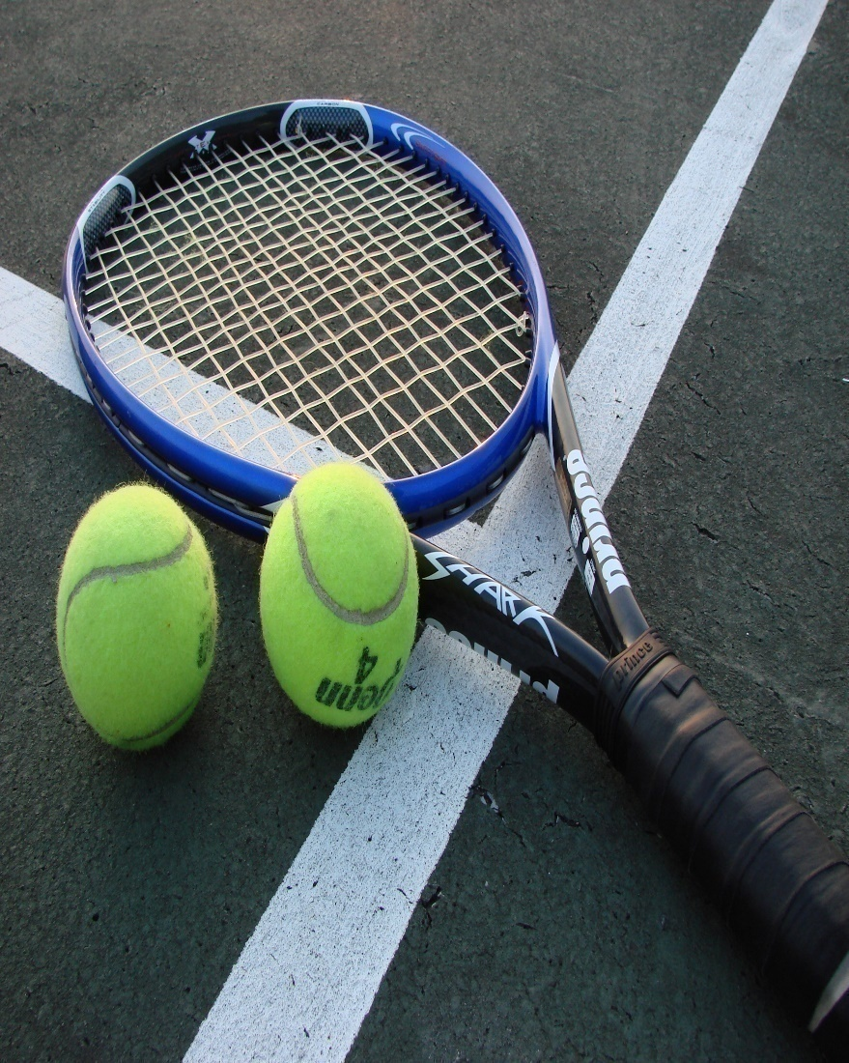
R r
Raket
Ra-ket
RACKET

Slide 25
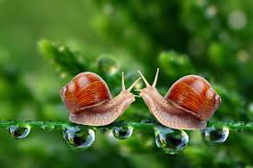
S s
Salyangoz
Sal-yan-goz
SNAİL

Slide 26
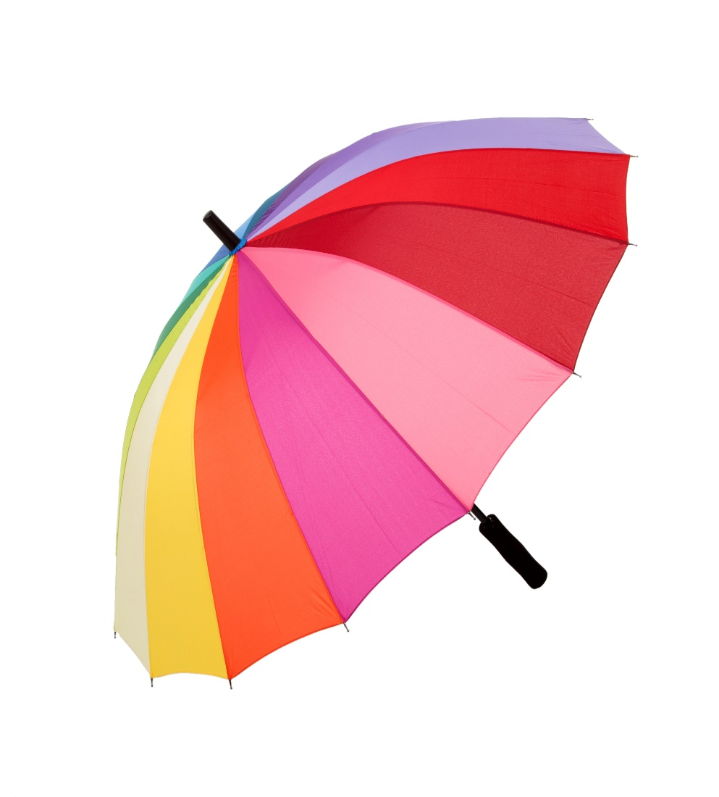
Ş ş
Şemsiye
Şem-si-ye
-SH-
Shell
Shake
UMBRELLA

Slide 27
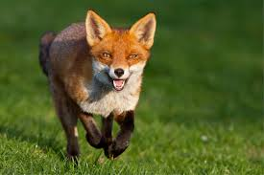
T t
Tilki
Til-ki
FOX

Slide 28
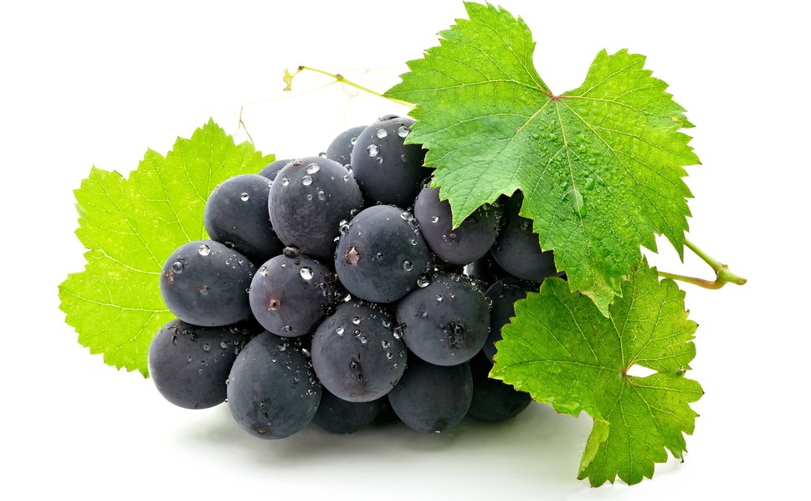
Ü ü
Üzüm
Ü-züm
GRAPE

Slide 29
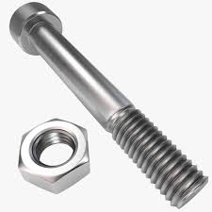
V v
Vida
Vi-da
SCREW

Slide 30
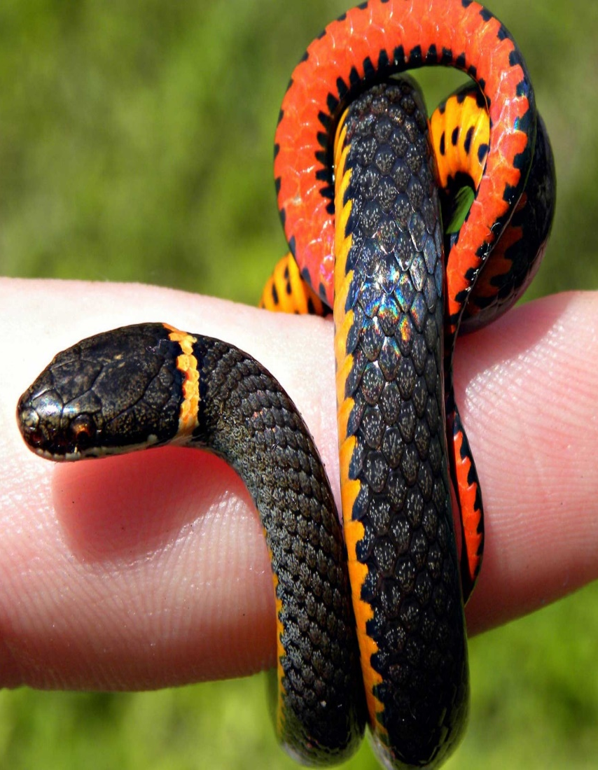
Y y
Yılan
Yı-lan
SNAKE

Slide 31
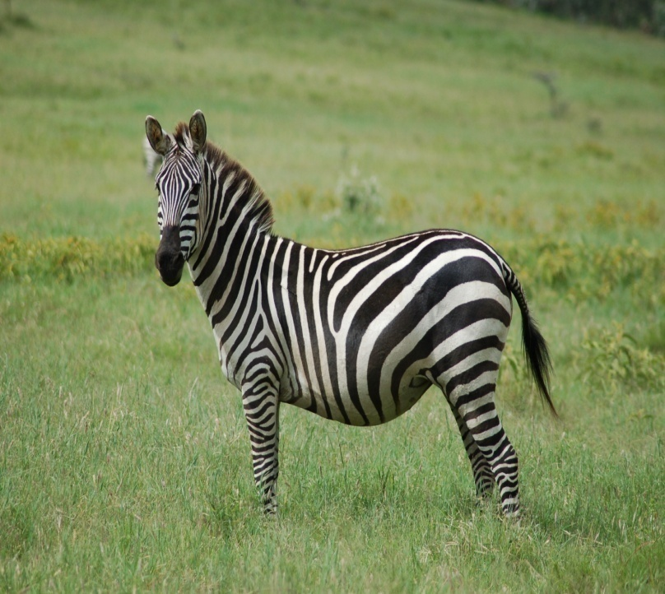
Z z
Zebra
Zeb- ra
ZEBRA

